Slide 1

HIRING PROCESS ANALYTICS
Project no. 4 :- USING EXCEL STATISTICS

Slide 2
TASK TO CARRY OUT IN THIS PROJECT
TASKS :-
HIRING ANALYSIS.
SALARY ANALYSIS.
SALARY DISTRIBUTION.
DEPARTMENT ANALYSIS.
POSITION TIER ANALYSIS.

Slide 3
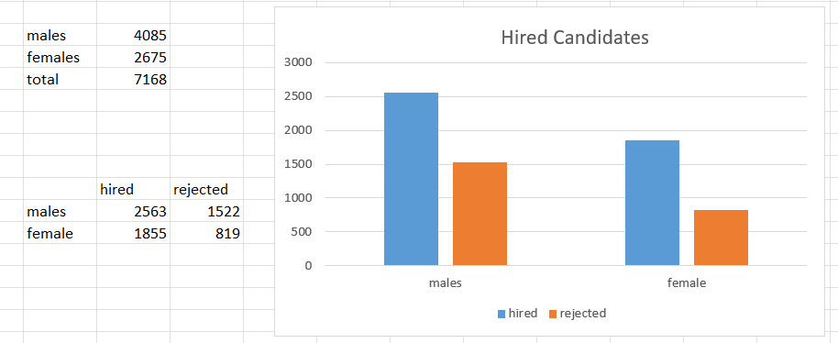
HIRING ANALYSIS.
The hiring process involves bringing new individuals into the organization for various roles.
The task here is to determine the gender distribution of hires. How many males and females have been hired by the company?
We will first calculate all the males and females using count functions and then calculated hired or rejected using Countifs function.

Slide 4

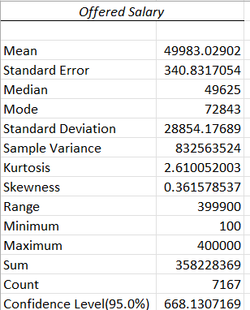
SALARY ANALYSIS.
The average salary is calculated by adding up the salaries of a group of employees and then dividing the total by the number of employees.
The task here is to determine the average salary offered by this company?
We can use the Data Analysis function in the data ribbon in excel to find out the average and other statistics or we can use the average function to find the salary.

Slide 5
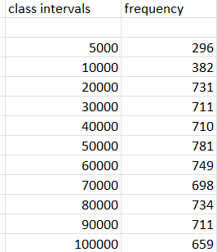
SALARY DISTRIBUTION.
Class intervals represent ranges of values, in this case, salary ranges. The class interval is the difference between the upper and lower limits of a class.
The task here is to Create class intervals for the salaries in the company. This will help you understand the salary distribution.
We first decided class intervals and then used frequency function to find out the output needed.

Slide 6
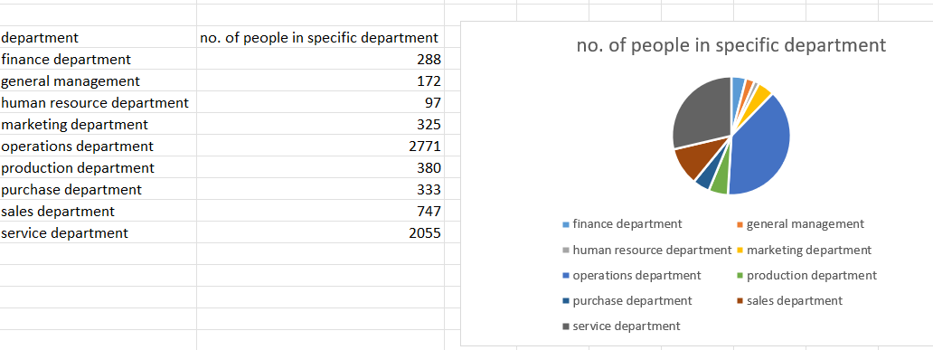
DEPARTMENT ANALYSIS.
Visualizing data through charts and plots is a crucial part of data analysis.
The task here is to use a pie chart, bar graph, or any other suitable visualization to show the proportion of people working in different departments.
We first use countif function to calculate no. of people in each department and then apply the pie chart.

Slide 7
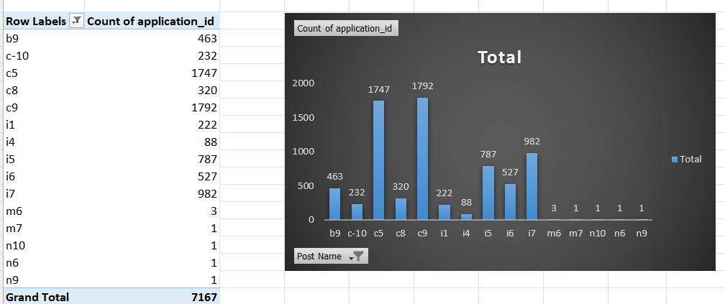
POSITION TIER ANALYSIS.
Different positions within a company often have different tiers or levels.
The task here is to use a chart or graph to represent the different position tiers within the company. This will help you understand the distribution of positions across different tiers.
We first make a pivot table and then select two columns that are application id and post name to get the desired output

Slide 8
INSIGHGTS
There were some missing values so addressing and filtering them out is a crucial task in data analysis for maintaining data integrity.
Using latest version of excel also helped a lot in getting all of the required statistics in one go.
By using Excel functionalities this project gave valuable insights through data cleaning we understood deeply what the data was about and how easily the output was obtained.
GOOGLE DRIVE LINK
Link of the excel sheet where I did my analysis

Slide 9
THANK YOU.

